Slide 1
Countries & Nationalities
yasamansamsami@gmail.com

Slide 2
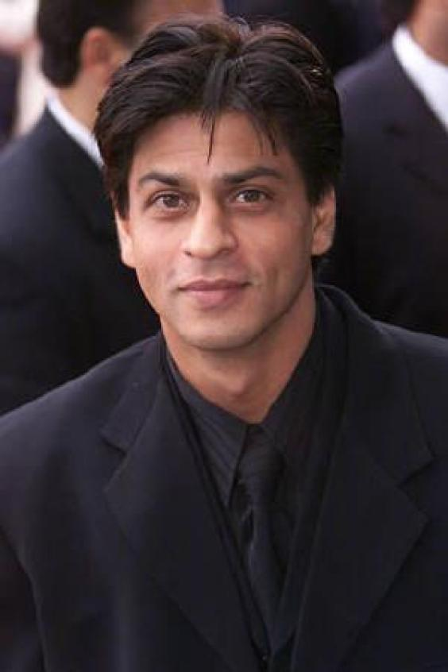
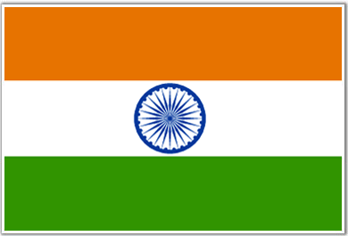
India
This is Shahrukh Khan. He is an Indian actor.

Slide 3
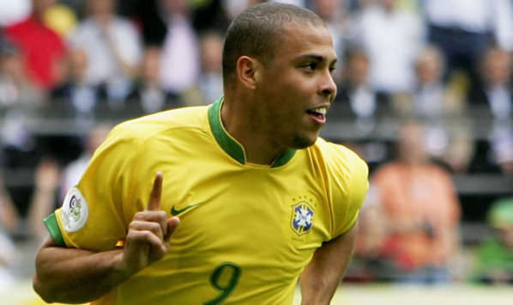
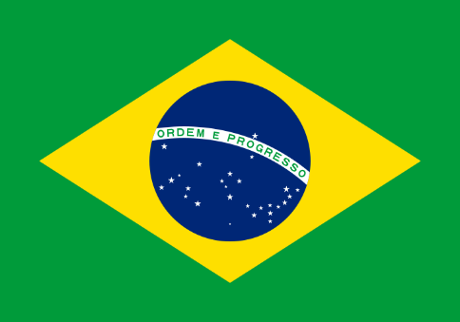
Brazil
This is Ronaldo. He is a Brazilian footballer.

Slide 4
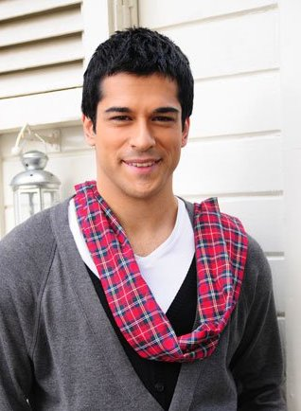
Turkey
He is a Turkish actor.

Slide 5
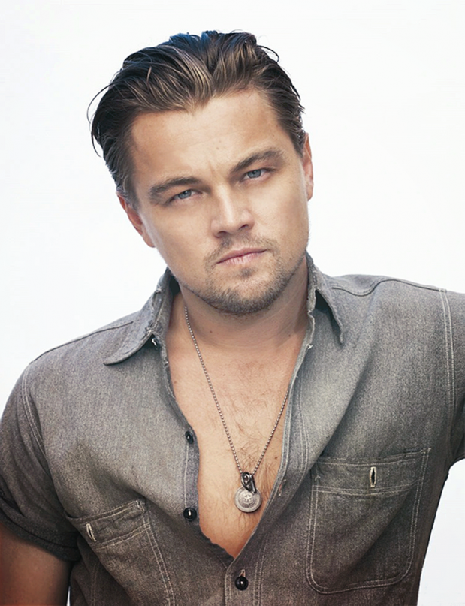
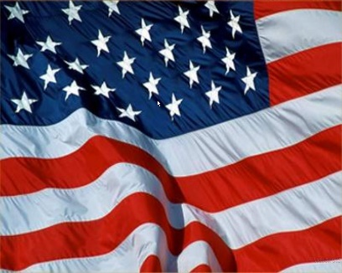
The USA
This is Leonardo DiCaprio. He is an American actor.

Slide 6
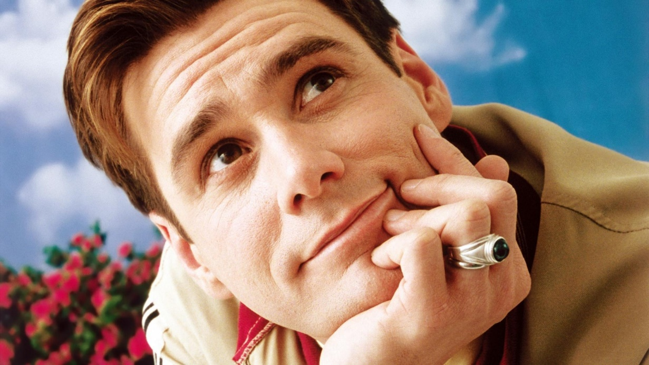
Canada
This is Jim Carrey. He is a Canadian actor.

Slide 7
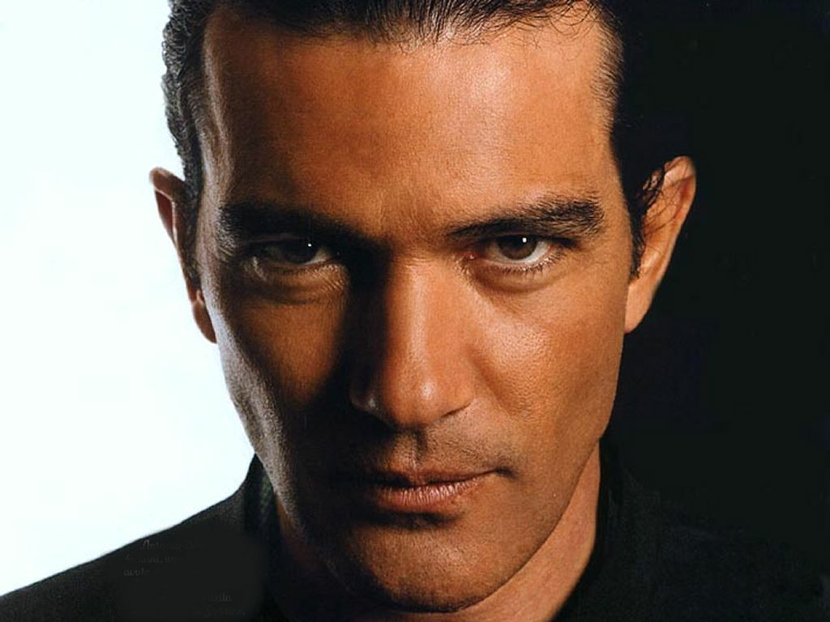
Spain
This is Antonio Bandrass. He is a Spanish actor.

Slide 8
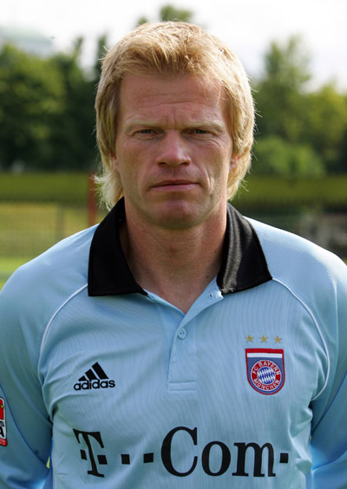
Germany
This is Oliver Kahn. He is a German footballer.

Slide 9
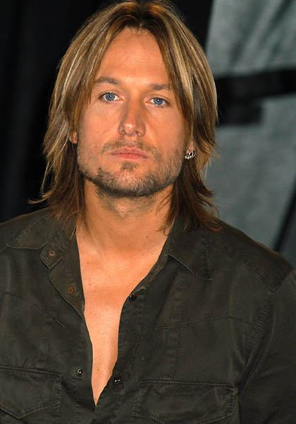
Australia
This is Keith Urban. He’s an Australian singer.

Slide 10
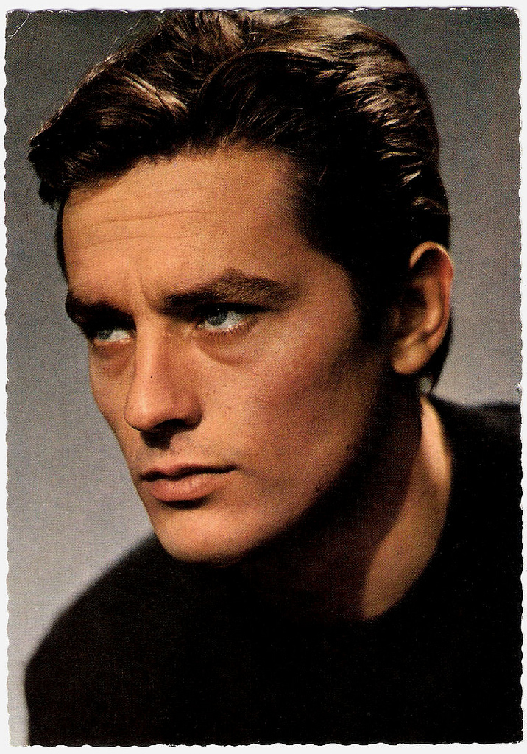
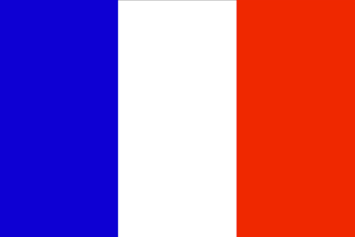
France
Alen Delon is a French actor.

Slide 11
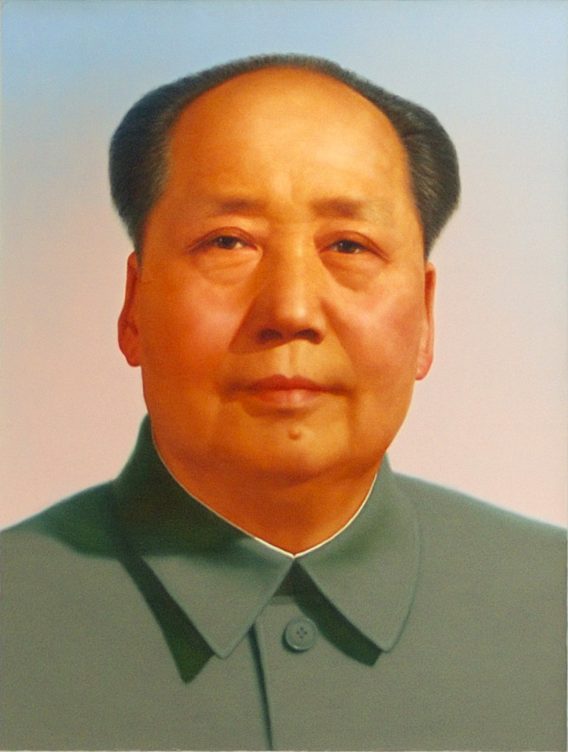
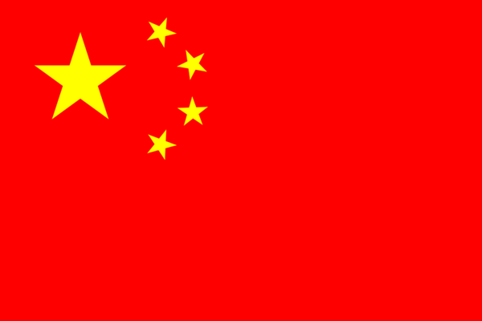
China
Mao was a Chinese politician.

Slide 12
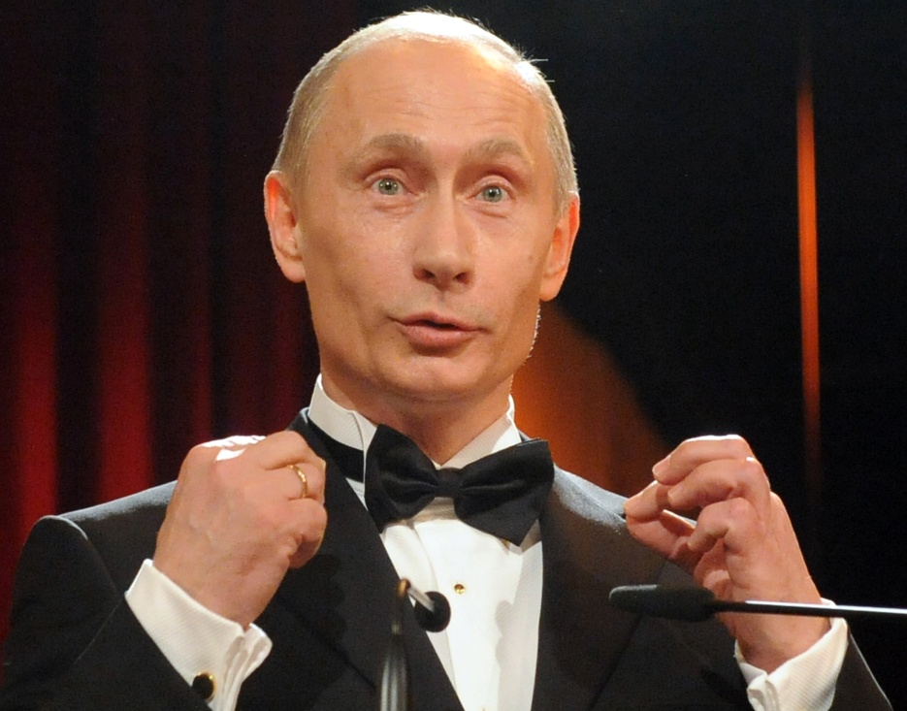
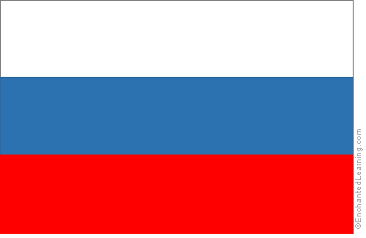
Russia
This is Putin. He is a Russian politician.

Slide 13
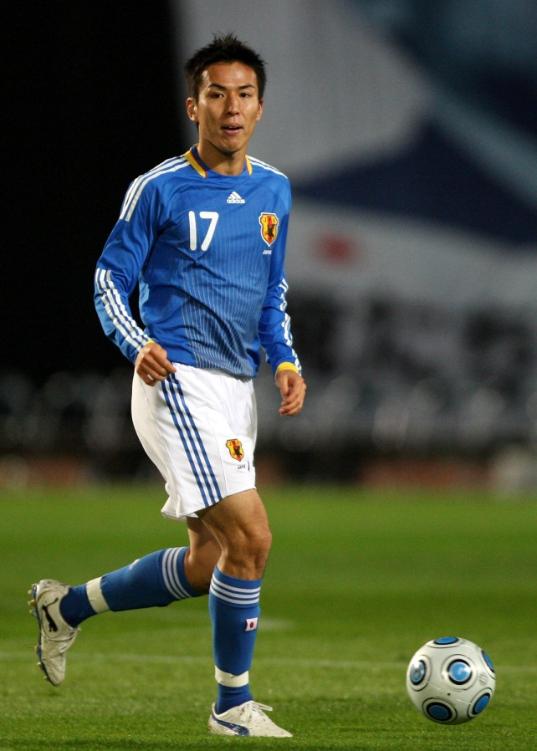
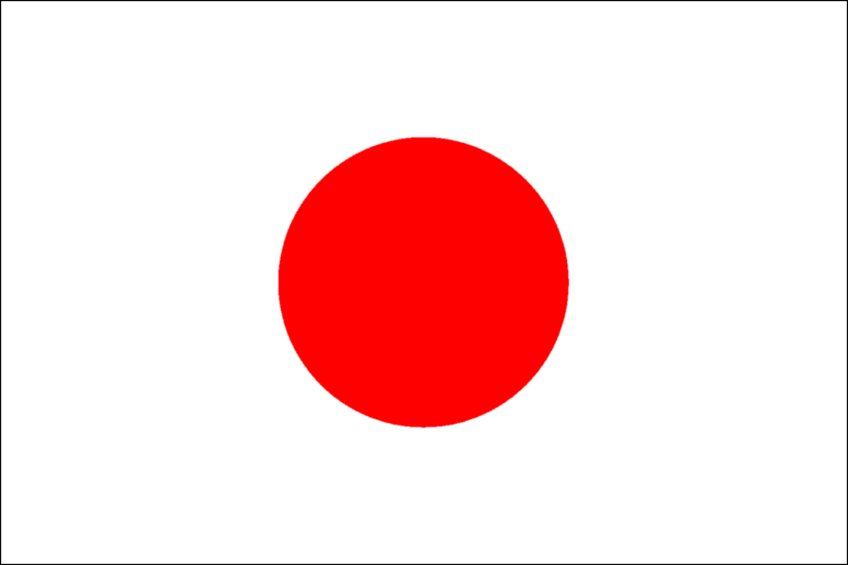
Japan
This is Makoto Hasebe. He’s a Japanese footballer.

Slide 14
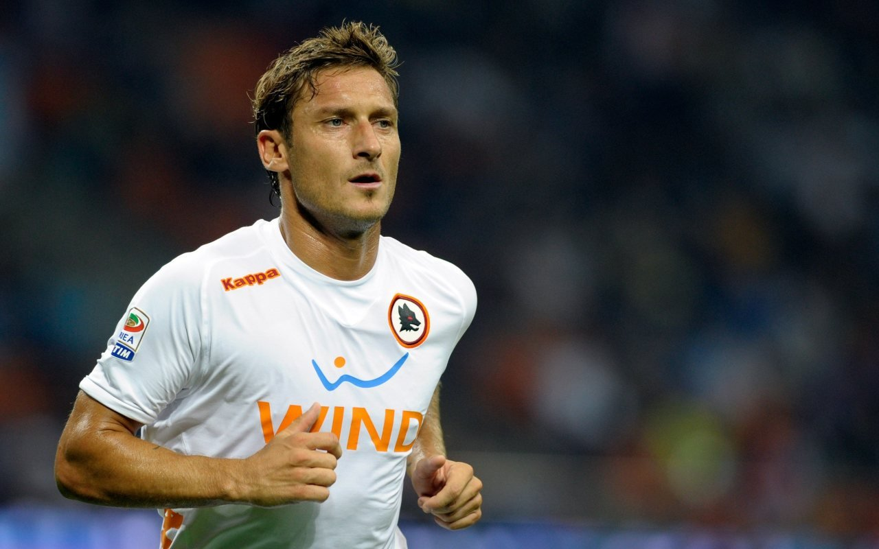
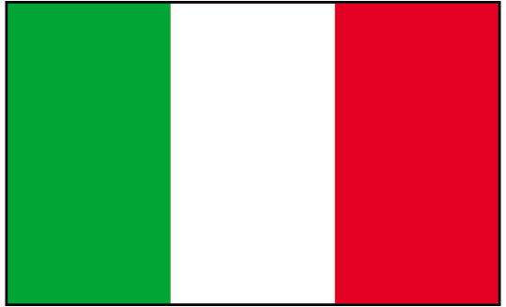
Italy
This is Toti. He’s an Italian footballer.

Slide 15
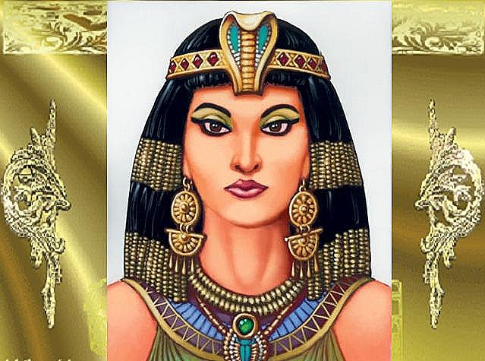
Egypt
Cleopatra, was the last Egyptian .

Slide 16
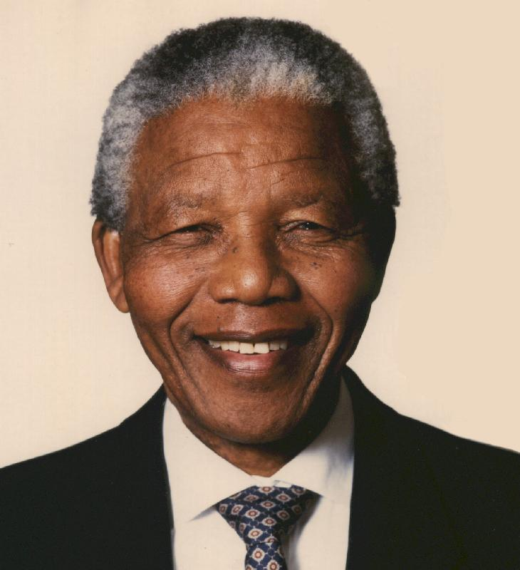
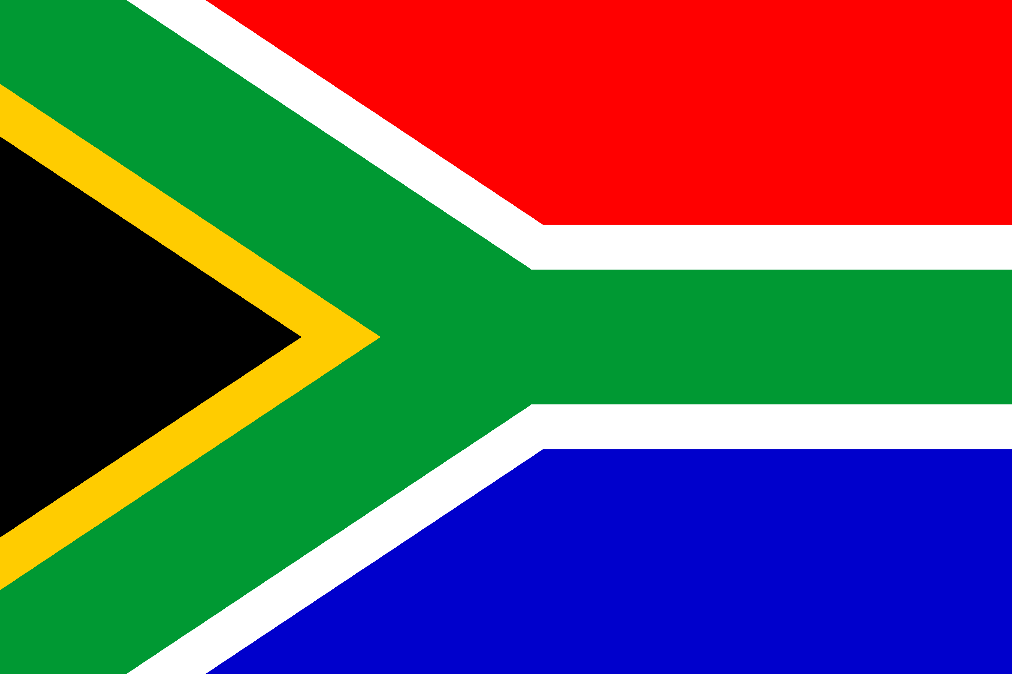
South Africa
Nelson Mandela was a South African President.

