Slide 1
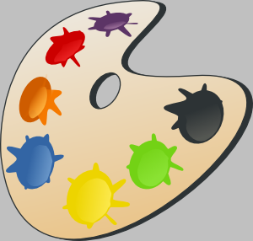

Slide 2
black

Slide 3
brown

Slide 4
red

Slide 5
orange

Slide 6
yellow

Slide 7
green

Slide 8
blue

Slide 9
grey

Slide 10
pink

Slide 11
purple

Slide 12
white

