Slide 1
Adverbs of Frequency
How often do you go to the cinema?
Sometimes. Once a month.

Slide 2
Adverbs of indefinite frequency
Adverbs of indefinite frequency mainly go in MID position in the sentence.
They go before the main verb (except the main verb "to be")
We usually go shopping on Saturday.
I have often done that.
She is always late.
Occasionally, sometimes, often, frequently and usually can also go at the BEGINNING OR END of a sentence:
Sometimes they come and stay with us.
I play tennis occasionally.
Rarely and seldom can also go at the END of a sentence (often with "very"):
We go shopping rarely.
John eats meat very seldom.

Slide 3
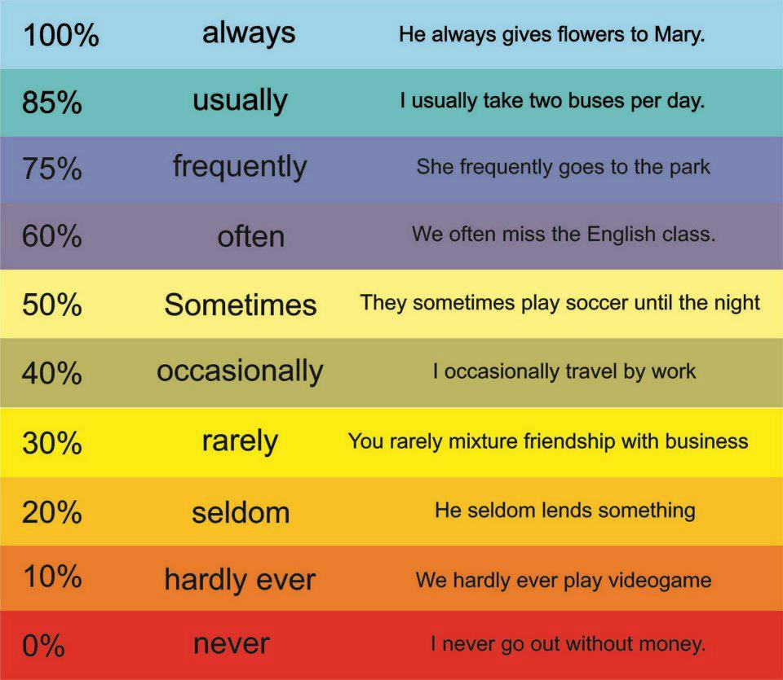

Slide 4
Adverbs of definite frequency
Adverbs of definite frequency, like all adverbs of definite time, typically go in END position. Look at these examples:
Most companies pay taxes yearly.
The manager checks the toilets every hour.
The directors meet weekly to review progress.
Sometimes, usually for reasons of emphasis or style, some adverbs of definite frequency may go at the FRONT, for example:
Every day, more than five thousand people die on our roads.
Examples:
hourly, daily, weekly, monthly, yearly
every second, once a minute, twice a year
once, twice, once or twice, three times

Slide 5
Place in sentences
Adverbs of frequency are put directly before the main verb. If 'be' is the main verb and there is no auxiliary verb, adverbs of frequency are put behind 'be'. Is there an auxiliary verb, however, adverbs of frequency are put before 'be'.
subject | auxiliary/be | adverb | main verb | object, place or time
I |  | often | go swimming | in the evenings.
He | doesn't | always | play | tennis.
We | are | usually |  | here in summer.
I | have | never | been | abroad.

Slide 6
How often or How many times?
How often do you play tennis?
I often / sometimes / never play tennis.
How many times do you play tennis?
I play tennis once / twice / three times a day / week / year.
How often do you walk the dog?
I often / sometimes / never walk the dog.
How many times do you walk the dog?
I walk the dog once / twice / three times a day / week / year.

Slide 7
Twice a day, Once a week,
Three times a month
How often do you brush your teeth?
I brush my teeth twice a day.
Once a | day | week | year
Twice a | day | week | year
Three times a | day | week | year
Four times a | day | week | year
Five times a | day | week | year

Slide 8
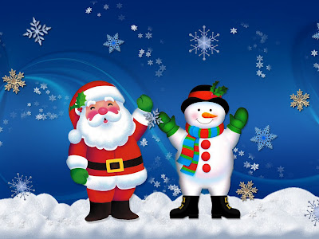
daily, monthly, yearly
How often do you brush your teeth?
I go to bed daily.(every day)
How often do you celebrate Christmas?
I celebrate Christmas yearly. (once a year)

